Slide 1

Bot & Attack Detection Techniques

Slide 2
1. Threshold Detection
Threshold detection involves setting predefined limits on certain metrics (e.g., requests per second, login attempts) and triggering alerts or blocks when those limits are exceeded.
How it works
Pros & Cons
Monitor a specific metric (e.g., HTTP requests, API calls, failed logins)
Define a threshold value (e.g., >100 requests/min from one IP)
Trigger an action (alert, block, CAPTCHA) when the threshold is crossed
Pros
Cons
Simple to implement
High false positives
Low computational cost
Easily bypassed by slow attacks
Use Cases
Easy to tune
Doesn't detect distributed attacks well
Rate limiting APIs
Detecting DDoS attacks
Preventing account enumeration

Slide 3
2. Brute Force Detection
Brute force detection identifies repeated, systematic attempts to guess credentials, keys, or tokens by monitoring failed authentication patterns.
How it works
Detection Signals
Track failed login attempts per user/IP/session
Apply lockout or throttling after N failures
Detect credential stuffing via known breached password lists
Multiple failed logins in a short window
Common Strategies
Sequential username/password variations
Account lockout — lock after X failed attempts
Progressive delays — increase wait time after each failure
IP reputation checks — block known malicious IPs
MFA enforcement — add a second factor after suspicious activity
Same password tried across many accounts (credential stuffing)
Pros & Cons
Pros
Cons
Directly targets attack pattern
Can lock out legitimate users
Easy to implement
Distributed brute force evades IP-based rules

Slide 4
3. Payload Pattern Detection
This technique inspects the content of requests (body, headers, query strings) for known malicious patterns using signatures or rules.
How it works
Attack Patterns Detected
Inspect HTTP request payloads against a rule set
Match against known attack signatures (e.g., SQLi, XSS, LFI)
Block or flag matching requests
Attack Type
Example Pattern
SQL Injection
' OR 1=1 --
Common Rule Sets
XSS
<script>alert(1)</script>
OWASP ModSecurity Core Rule Set (CRS)
Snort/Suricata rules
YARA rules for file-based payloads
LFI
../../etc/passwd
Command Injection
; rm -rf /
Pros & Cons
XXE
<!ENTITY xxe SYSTEM...>
Pros
Cons
Catches known attacks reliably
Bypassed by obfuscation/encoding
Widely supported (WAFs)
Requires constant rule updates

Slide 5
4. Risk Scoring
Risk scoring assigns a numerical score to a user, session, or request based on multiple signals, enabling dynamic, context-aware decisions.
How it works
Score Bands Example
Collect signals (IP reputation, geo-location, device fingerprint, behavior)
Assign weighted scores to each signal
Aggregate into a total risk score
Apply policy based on score range (allow / challenge / block)
0–30
31–70
→ Allow
→ CAPTCHA / Step-up auth
Common Signals & Weights
71–100
Signal
Risk Weight
→ Block
Known malicious IP
High
Pros & Cons
Unusual geo-location
Medium
Pros
Cons
New device/browser
Medium
Flexible and context-aware
Complex to tune and calibrate
Abnormal request rate
High
Reduces false positives
Requires rich telemetry data
Valid session token
Low (reduces risk)
TOR/VPN usage
Medium–High

Slide 6
5. User-Agent Filtering
User-agent filtering inspects the User-Agent HTTP header to identify and block bots, scrapers, or known malicious tools.
How it works
Limitations
Parse the User-Agent header from incoming requests
Compare against blocklists (known bad bots) or allowlists (known good bots)
Flag empty, malformed, or suspicious user-agent strings
User-agents are easily spoofed — should never be used alone
Must be combined with behavioral signals for accuracy
Pros & Cons
Categories
Pros
Cons
Category
Example
Quick and cheap to implement
Trivially bypassed by spoofing
Known bad bots
sqlmap, Nikto, Havij
Catches unsophisticated bots
High false negatives
Headless browsers
HeadlessChrome, PhantomJS
Empty/missing UA
"" or absent header
Spoofed UA
Fake browser string with bot behavior
Legitimate crawlers
Googlebot, Bingbot

Slide 7
6. AI/ML Detection
AI/ML-based detection uses machine learning models to identify anomalous or malicious behavior by learning patterns from historical data rather than relying on static rules.
Core Approaches
Common Algorithms
Approach
Description
Random Forest — classification of attack types
Isolation Forest — anomaly/outlier detection
LSTM — sequential behavior modeling
Autoencoders — reconstruct normal traffic; flag deviations
Graph Neural Networks — detect fraud rings and bot networks
Supervised Learning
Train on labeled attack/normal data (e.g., Random Forest, XGBoost)
Unsupervised Learning
Detect anomalies without labels (e.g., Isolation Forest, Autoencoders)
Advantages over Rule-Based Systems
Deep Learning
Use LSTMs/Transformers for sequence-based attack detection
Detects zero-day and unknown attack patterns
Adapts to evolving threats over time
Handles high-dimensional feature spaces
Reduces manual rule maintenance
Reinforcement Learning
Adaptive systems that improve based on feedback
What ML Models Learn
Pros & Cons
Normal user behavior baselines
Temporal patterns (time-of-day access)
Navigation flow anomalies
Feature correlations across multiple signals
Pros
Cons
Detects novel/unknown attacks
Requires large labeled datasets
Self-improving over time
Black-box models are hard to explain
Low false positives (when tuned)
Computationally expensive
Handles complex patterns
Vulnerable to adversarial ML attacks

Slide 8
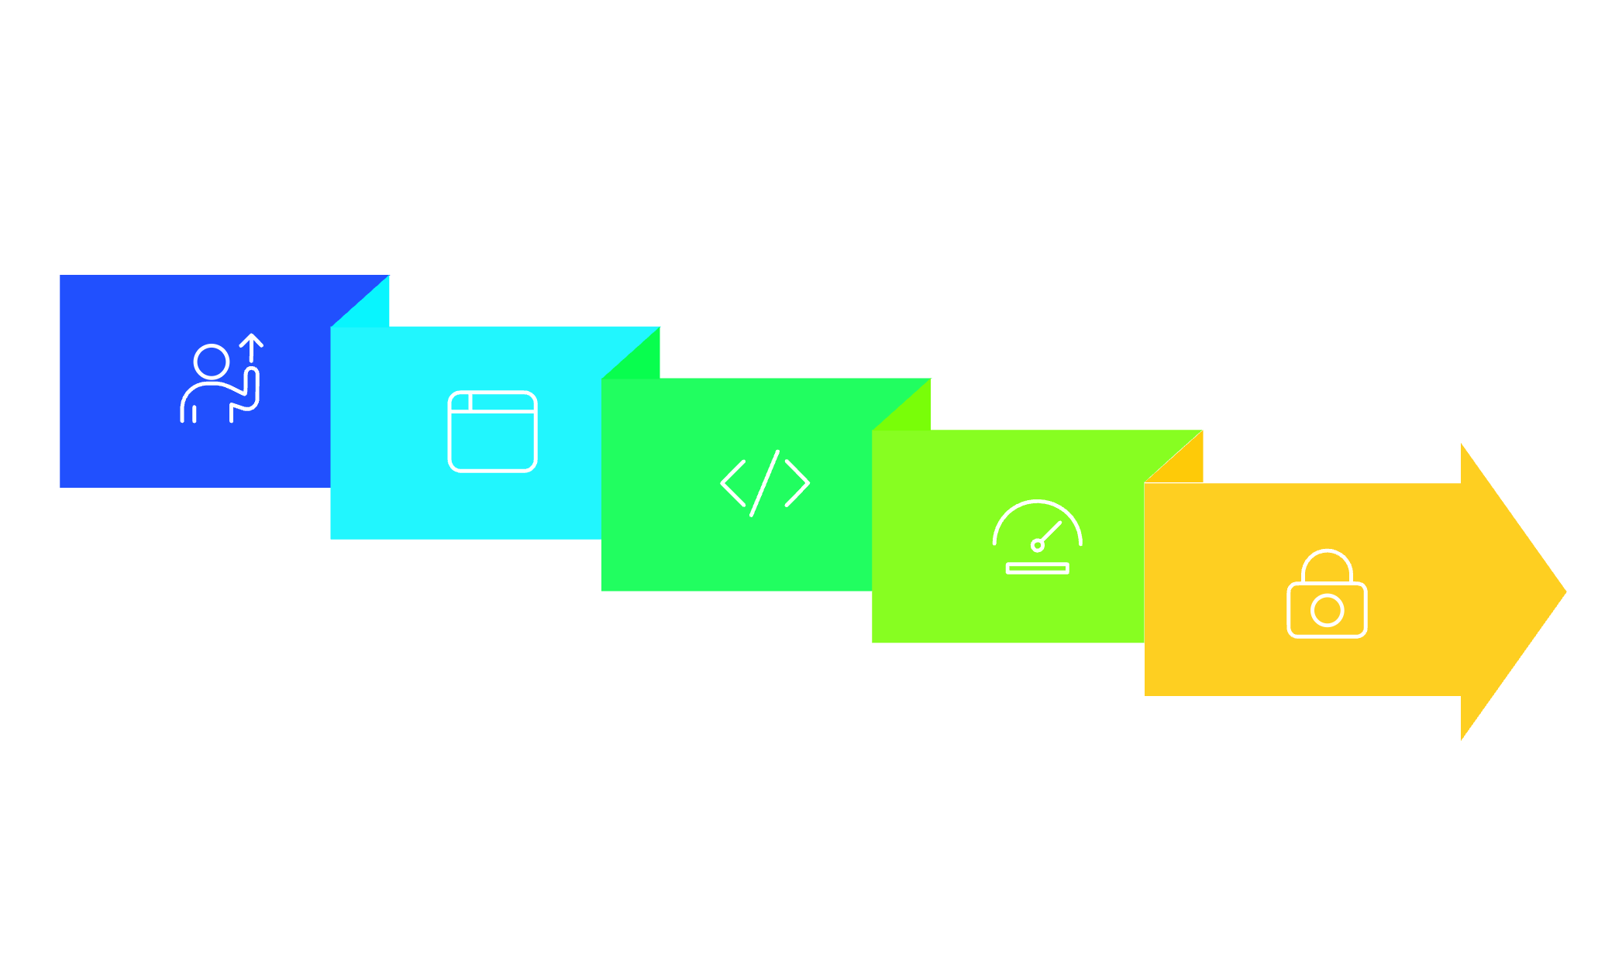

Combining Techniques
No single technique is sufficient. A robust security system layers these approaches:
Request
Payload Pattern
Brute Force Detect
User-Agent Filter
Threshold Check
Best Practice: Use rule-based methods (threshold, payload, UA filtering) as fast pre-filters, and AI/ML + risk scoring as the intelligent decision layer for complex or ambiguous cases.

Slide 9
Advanced Integration
Adaptive Thresholds with ML
Behavioral Biometrics + AI
Static thresholds are easily bypassed. Modern systems use adaptive thresholds powered by ML:
Beyond request patterns, advanced systems analyze user behavior:
Dynamic rate limits based on user behavior (e.g., a dev API user vs. a mobile app user)
Time-series forecasting to predict normal traffic and flag deviations
Seasonal adjustment — e.g., higher thresholds during Black Friday sales
Mouse movements, keystroke dynamics, scroll patterns
Session duration, navigation paths, feature usage
Device fingerprint stability (e.g., sudden change in screen resolution or timezone)
These signals feed into risk scoring engines and help distinguish real users from bots or hijacked sessions.
Example: A user who normally makes 5 requests/sec suddenly makes 50 → triggers anomaly score, not static block.

Slide 10

AI vs. Adversarial Attacks
ML models are powerful — but vulnerable to adversarial manipulation:
Evasion Attacks
Attackers can craft inputs to evade detection (e.g., obfuscated payloads that fool classifiers)
Adversarial Training
Train models on adversarial examples to improve robustness
Ensemble Models
Combine multiple models to reduce single-point failure
Example: An attacker modifies SQLi payload to sElEct 1 — a rule-based system may miss it, but an ML model trained on obfuscated variants can still flag it.

Slide 11

Risk Scoring in Practice: Example Workflow
01
02
Request arrives → Extract signals
Aggregate scores
IP: 192.168.1.100 (unknown, not in blocklist)
User-Agent: "Mozilla/5.0 (Windows NT 10.0; rv:102.0) Gecko/20100101 Firefox/102.0"
Geo: United States (normal)
Device: New fingerprint (medium risk)
Request rate: 12 req/sec (high for this user → high risk)
Payload: Contains "SELECT * FROM" → pattern match → high risk
IP: 10
UA: 5
Geo: 0
Device: 20
Rate: 30
Payload: 40
→ Total: 105 → Block
03
AI model override?
→ Model predicts 92% chance of SQLi → Confirms block.

Slide 12

Evaluation Metrics for Detection Systems
To measure effectiveness, track:
Metric
Description
Precision
% of blocked requests that were truly malicious
Recall
% of malicious requests correctly blocked
F1-Score
Harmonic mean of precision & recall
False Positive Rate (FPR)
% of legitimate requests blocked
Mean Time to Detect (MTTD)
How fast threats are caught
Mean Time to Respond (MTTR)
How fast action is taken
Goal: Maximize recall & precision, minimize FPR — often requires trade-offs.

Slide 13
Common Pitfalls & Mitigations
Over-reliance on User-Agent
Static thresholds
Mitigation: Combine with behavioral signals
Mitigation: Use adaptive, ML-driven limits
Rule-only systems
Ignoring false positives
Mitigation: Add AI/ML for unknown threats
Mitigation: Implement feedback loops and tuning
No explainability
Poor data quality
Mitigation: Use SHAP/LIME for model interpretability
Mitigation: Clean, label, and augment training data

Slide 14
Tools & Frameworks
Technique
Tools
Payload Pattern Detection
ModSecurity, OWASP CRS, Snort
Threshold/Brute Force
Fail2Ban, Nginx rate limiting, Cloudflare WAF
Risk Scoring
Sqreen, Datadog RASP, AWS WAF + AWS Fraud Detector
AI/ML Detection
TensorFlow, Scikit-learn, Hugging Face, Amazon SageMaker
Behavioral Biometrics
PerimeterX, DataDome, F5 Advanced WAF

